Slide 1
Multiply by multiples of 10

Slide 2
Let’s Review
20 x 3
= 6 tens
or 60
2 tens x 3
Multiply

Slide 3
Let’s Review
Multiply.
50 x 7 = ?
5 tens x 7
= 35 tens or 350
10 x 10 = ?
1 ten x 10
= 10 tens or 100

Slide 4
What if both factors were 2 digit numbers
I can use place value
20 x 15
2 tens x 15
= 30 tens
or 300

Slide 5
I can break apart the factors
40 x 50
x
x
x
4 x 10
4
x
10
5 x 10
5
10
( )
( )
Then I multiply 2 factors at a time.
The commutative property of multiplication says I can multiply factors in ANY order.
20 x 100
20 hundreds
or 2000
Notes:
They could also break apart one factor. For example:
40 x 5 x 10
20 tens x 10
200 x 10 (two hundred tens)
2000

Slide 6
Solve
Try it Out!

Slide 7
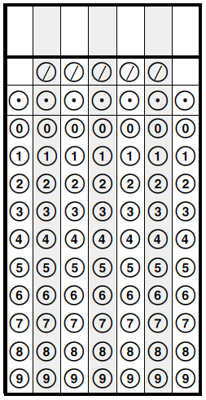
What is the product of 30 and 80?
Notes:
2400
They can grid any where in the chart, as long as the numbers are in consecutive boxes.

